Slide 1
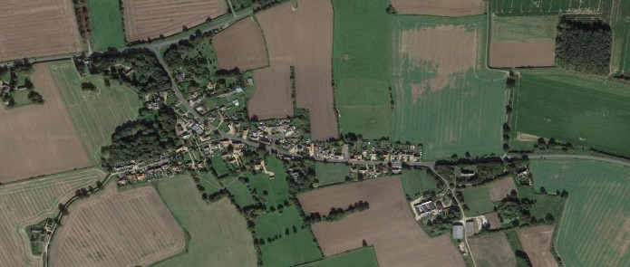


Crimplesham Parish Council
Newsletter
From the Parish Council Deputy Chairman
Welcome to the latest edition of our village newsletter. Since our last publication we have
unfortunately had to accept the resignation of our Biodiversity champion, Cllr Gina Ashman for
personal reasons. I and on behalf of everyone else will truly miss her enthusiasm for all things green,
from planting various trees and shrubs to enhancing the look of our village social areas to
championing bee friendly plants in our private gardens. With regards to our green spaces, I hope you
all enjoyed some great weather and managed to fully appreciate our new playing field equipment
whether it be friends or family members. As the Parish Council we continue to serve all our
Parishioners to the best of our ability by continuing to support and champion the improvement of
our lovely village so please be forthwith with any ideas you deem beneficial. On a safety note, with
the night’s drawing in please stay visible to the good drivers and not so good, who believe our road
is a national speed limit thoroughfare. We will be in tandem with personal safety, ensuring all street
lighting is in full working order.
Getting away from the doom and gloom of road safety, I as Vice Chair, all of my fellow councillors
and our fantastic Clerk wish you all a wonderful remaining 2025.
Village Hall
The village hall was sold by auction in June 2025 with the sale completed on the 26 August 2025. The sale completed a lengthy process for the trustees of the village hall who completed the task with the consent of a majority vote carried out within the village, successfully concluded with a sale value of £190.000.00.
The trustees are working with the Charity commission and their solicitors to conclude the financial arrangements and the winding up of this charity.
When the trustees are able to provide final information on the financial arrangements with regard to the sale and the allocation of the funds, they will inform the village.
Whilst there are different opinions regarding the viability of the hall, the trustees have worked with the best interest of the village and preservation of this lovely building, giving the new owners the opportunity to renovate the building. We wish the new owners well and welcome them to the village of Crimplesham
Ann Woods Crimplesham Village Hall Trustee
clerk@crimplesham-pc.gov.uk
For further information Norfolk County Council has a road safety team on 0344 800 8020 or email

Slide 2



Vacancies for Parish Councillors
Would you like to make a positive
difference in our village? As a Parish councillor, you can influence decisions that affect our community.
Following resignations , we are looking to co-opt new councillors to the Parish Council.
Further information about the Parish Council can be found on our website www.crimplesham-pc.gov.uk
Should you wish to be considered or find out more about the position of Parish Councillor, please contact Melanie Hilton , Parish Clerk at
clerk@crimplesham-pc.gov.uk
Would like to make a difference, and be involved in shaping the future of your local community?
Village Playing Field
The Parish council have ben requested to consider
Installing a pedestrian gate at the other end of
the playing filed to allow access. This has been
considered and have budgeted for the gate top
be installed in 2006/27
We are grateful to Nicola Booth for volunteering to
Manage the waste bin within the playing filed.
Speed Camera
The speed camera has now been returned and
And installed back into the village. The camera is
jointly owned by Crimplesham and Fincham Parish
Councils. After the departure of Gina Ashman, we
were unable to facilitate the management of the
Camera in the village, now we are grateful to
Ian Wright for volunteering to manage this on behalf
of the village.
Remembrance Day
The council have purchased two metal
“Tommy figures” which will be placed alongside
The village sign for remembrance day.
We have are also placing a number of
“Tommy Lamp Post signs” at the village entrance
and within the village.
St Mary's Church
Thank you to everyone who attended the recent community meetings for St Mary’s Church and to those who completed our community survey. Your input is invaluable as we seek to ensure the future of the church as an asset
for the village. There is still time to find out more and share your opinions by completing the survey here: is.gd/crimpleshamchurch.
The Parochial Church Council (PCC) is
considering forming a Friends Group to help with tasks like grant
applications, minor maintenance, engaging the community, and exploring ways the building may be reshaped to serve the congregation and community better.
If you would like to be involved with a group to help support the church, please complete the survey or contact Revd. Nigel Moat directly at nigelmoat@ousevalleybenefice.
org or call 07421 117112.
Bus Shelter
The refurbished bench has now been placed
within the bus-shelter. We still require people in
the village to contact our Parish Clerk if they
Would like the bus service re-instated within the
village. We can only fight for this service if we
have the backing of the villagers who would
Use this service.
This newsletter is now sponsored. To advertise
please contact the Clerk at
clerk@crimplesham-pc.gov.uk

