Slide 1
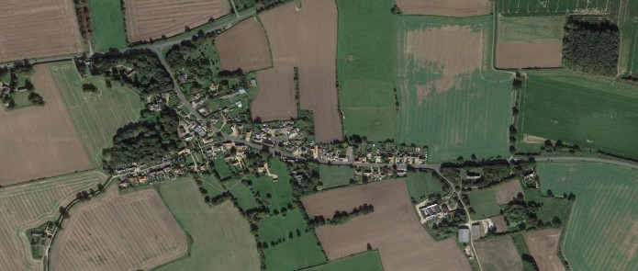



Crimplesham Parish Council
Newsletter
From the Parish Council Chairman
You may be aware from the notices published that Councillor Jeffery Carter has now retired from the parish council
due to ill health. Jeffery has been a long-standing member of the parish council with a Approx.45 years served as a
councilor. In talking with Jeffery, he recaps on the early days of the parish council with many happy memories when
the community came together to enjoy events in the village such as family fun days on the playing field. I am sure you
will all join me in wishing Jeffery all the very best for the future and in letting him know, we are able to support him
If and when he wishes.
Village Speeding
The speed camera is currently being utilised by the parish of Fincham who are using this for an extended period due to the camera not functioning for a short period. The camera will be back in the village in November.
We are all aware that speed reduction measures are a costly installation and that there are insufficient funds to install without exceptional reasons. We believe our village is used as a short cut for some heavy goods vehicles and cars that are not able to comprehend what 30 MPH refers to.
Do we accept this or should we start to push for some reduction measures before an accident occurs involving people in the village. One such measure will be to start a petition that we will forward to our local MP and others to show we are united in trying to raise awareness of the issue we have. We are aware other villages have similar problem, but we need to think about Crimplesham and what we can do to engage others to aid our cause. Being proactive is better than reactive after the event.
Please let us know if you believe this would be a worthy cause?
crimpleshamparishcouncil@gmail.com. For further information Norfolk County Council has a road safety team on 0344 800 8020 or email roadsafety@norfolk.gov.uk. From Cllr Ashman

Slide 2




The Crimplesham Biodiversity Group
(protect our wildlife)
🐝 happy Crimplesham
As we have not had another meeting it is still lovely to know parishioners are keen to help in planting and offering plants bulbs to plant to enhance the village biodiversity.
After gaining Woodland Trust consent we will have donated saplings for hedging to plant along the metal fence in the playground.
Generous donations of bulbs and a buddleia bush for planting up tyres in the playground will be a lovely addition as are bulbs under the newly planted cherry trees by the village sign.
Any other ideas advice or support offered will be warmly welcomed .
Looking forward to your ongoing support
Cllr Gina Ashman
Village Playing Field
Last year we successfully gained funds for new
equipment to be Installed in the playing field
alongside a picnic table which we completed in the
latter part of the year we have recently applied for
funds to change some of the old equipment which
incudes the swings, metal climbing frame and to
adda full Size goal post with net as requested by
one of the villagers.
We have been successful in obtaining this funding
and have decided to wait until early spring before
carrying out this work due to the potential damage
That might be caused to the field in wet weather.
We also recently asked for your support to obtain a
lottery funding for a climbing wall for the
playing field. We received the support and have
now been successful in gaining lottery funding for
this installation. This will also be left to early spring.
We would like to thank you for your support and
hope this will provide enjoyable activities for the
children (and adults).
We have also been told that a figure of £2k can be
donated to the parish council for the installation
of adult exercise equipment in the playing field along
with a bench which has been donated.
The council would like to thank a kind parishioner for
this offer and it will be discussed at the council
meeting in November.
Village Green
We have planted two flowering Cherry trees on the
village green with the aim of improving the outlook
of the green. Thank you all for your help with this
on Saturday, 26 October.
Bus Shelter
We are currently looking to get the bus shelter
cleaned and to place a bench inside the
Shelter, for obvious reasons.
The old bench, currently next to the bus shelter,
will be refurbished and placed in the playing filed.

