Slide 1
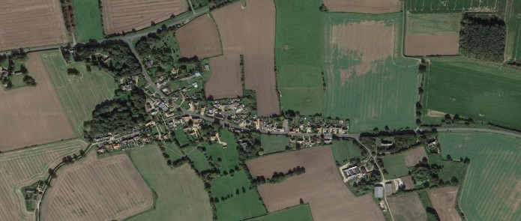



Crimplesham Parish Council
Newsletter
From the Parish Council Chairman
It is with great sadness that I learnt Jeffery Carter passed away on the
19 March. As you all aware, Jeffery was a Parish Councillor for many years,
and was passionate about the village, and , as he told me at one of our chats in his conservatory,
he has seen many changes in the village. I know he will be missed.
I also have great pleasure in announcing that Ann Woods has joined us a new Parish Councillor
and will help us on our strategy of continual improvement within Crimplesham.
Village Speeding
Fincham Parish Councillor Janice Lunan kindly arranged for the Sam 2 camera and batteries to have a service. All are working well, and monthly sharing of the camera now is reinstated.
Any comments on road speed or other issues can be fed into the SNAP Meetings held in Downham where anyone can attend to discuss community policing issues.
For further information Norfolk County Council has a road safety team on 0344 800 8020 or email roadsafety@norfolk.gov.uk. From Cllr Ashman
New Parish Councillor
A bit about myself !
Married, , Retired, 3 adult children, 5 grandsons.
Formerly mechanical engineering draughtswoman at
Sizewell A Nuclear power station
Love gardening , not very good at it though !
Reading, crafting
Became a Parish Councillor to help improve village
community , I am also a trustee of Crimplesham
Village Hall
Cllr Ann Woods

Slide 2




The Crimplesham Biodiversity Group
(protect our wildlife)
Spring is here and the lovely daffodils are looking beautiful around the village. New bulbs under planted last year when the two cherry trees were planted have burst into flower at the village sign site.
Thank you to the kind parishioners who helped on Saturday 8th of March who planted up the hedge saplings in the playground along the metal fence boundary. We had the best of sunny weather that day.
I would like to pay tribute to Mason Tofts who sadly died late last year who was a great ambassador for biodiversity in this village. He planted Cow slips along Willow Heath Road which are so pretty this time of year.
Every year they pop up he will be remembered .
With thanks to all who want to contribute to the future we have three large tractor tyres please offer any plants that you may have to plant up in these to add colour diversity and new habitats.
Looking forward to your ongoing support
Cllr Gina Ashman
Village Playing Field
The new equipment for the playing field is due to be
Installed in April and May. The council postponed
this work from last year to ensure we limited damage
to the grass area. The following will be installed:
Replacement swings
Replacement climbing frame
Replace one of the existing goal posts with
full size posts and net.
New climbing wall
New adult exercise equipment
Please be aware, the council have planted a
Number of tree saplings along the boundary with
The Old Rectory
Village Green
We have planted two flowering Cherry trees on the
village green with the aim of improving the outlook
of the green. Thank you all for your help with this
on Saturday, 26 October.
Dog bin
A new dog waste bin has been installed at the
Main Rd end of Market Lane. This has been
requested by a number of residents.
Bus Shelter
The bus shelter has now been cleaned, and we will
endeavor to maintain this throughout the year.
The old bench adjacent to the bus shelter will be
removed and refurbished. When complete, it will be
placed within the shelter.
VE Day
The 8th of May 2025 marks 80 years since
Victory in Europe, a momentous occasion
that signalled the end of World War II in
Europe. VE80 is a wonderful opportunity to
honor the heroes of the past, reflect on our
history, and celebrate peace and unity with
family, friends, and community.
The council would like to hold some form of
celebration within the village
and would welcome ideas from the villagers.
Some suggestions are a
BBQ on the playing field, cake stall or yard
sale for charity etc.
Let us try and come together on this one
Occasion, to show our appreciation and
put other issues aside.
Please let us know your ideas,

