Slide 1
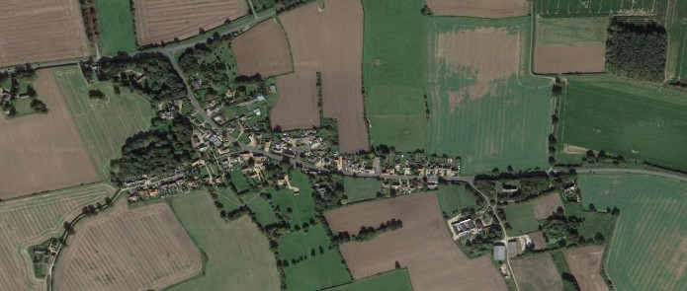
Crimplesham Parish Council
Newsletter
From the Parish Council Chairman
You may have noticed the clothes bin within the playing field has been over subscribed a number of
times in recent weeks. We have asked the collection company to review weekly and have ordered a
second bin to accommodate the quantity of donations being left. I have recently been informed that the
main reason for the increase in donations is due to the council waste site no longer accepting items
of clothing. Visitors are being informed to deposit at local collection bins such as in the playing field.
You will note below a section from the Trustees of the Village Hall regarding the current position of the
sale and allocation of funds. The Trustees of the playing field are also the councillors on the
Parish Council and we are working with the outgoing trustees of the village hall to assist in their wish
for a facility on the playing field for the benefit of the community.
Village Hall
Following the sale of the Village Hall in June 2025, the Village Hall Trustees have been working hard to finalise the closing of the charity. With the expert help of both the Charities Commission and our legal representatives we have been able to formally close the Crimplesham Village Hall Charity as of 10th March 2026. As such, we have been removed from the Central Register of Charities.
The funds remaining after paying all our legal costs stand at £189043.77. The trustees met and unanimously decided that the money should be donated to the Playing Field Trust within the village. We did discuss other ideas such as traffic calming, footpaths and other organisations who may have benefited from the amazing amount we had to donate. However, one of the stipulations of donating the money if that is has to be a used in the same way as our charity would of. This being a place for the village to meet and gather. The Playing Field Trust seemed the obvious choice. With this amount of money, they will be able to start the process of planning, building and executing the dream we had of bringing the community together.
This has been a very long and tough 4 years for the Trustees and former committee members. We have faced opposition, but we have also felt hope and kindness. We have always empathised with the feeling of people who held close the memories they created at the Village Hall. We have all the framed prints and trophies from the hall and all the paperwork from when the Hall was built to present day. These will be stored and kept safe until a new permanent home is found for them.
On behalf of myself, my fellow Trustees and former committee members I would like to thank those who have supported us. We wish the Playing Field Trust luck and success with their future endeavours.
Lucy Dodds
Trustee

Slide 2





Vacancies for Parish Councillors
Join Our Parish Council & Make a Difference Where You Live
Are you passionate about our community?
Do you have ideas, energy, and a desire to help shape the future of our parish?
We have 4 vacancies for co-option onto the Parish Council, and we’d love to hear from local residents who want to play an active role in making our area the best it can be.
What’s involved?
Attending council meetings every 8 weeks.
Listening to residents and representing their views.
Helping make decisions on local services, events, and improvements.
Working with other councillors to deliver projects that benefit everyone.
Who can apply?
If you’re a local Crimplesham resident, over 18, and meet the standard eligibility criteria for councillors, you’re welcome to put yourself forward. No prior council experience is needed, just enthusiasm, commitment, and a willingness to work as part of a friendly team.
How to express your interest?
To find out more pop along to the next meeting on Thursday 14 May 2026 at 18.45pm in the Methodist Church at Downham Market or contact the Clerk at clerk@crimplesham-pc.gov.uk
Village Playing Field
A new access gate will be installed at the opposite
end of the existing entrance to assist access to the
playing field.
Due to the excellent response for recycling at our
clothes bin in the playing field, we are considering
installing a second bin to meet the demand.
To assist with the conditions next winter, we have
installed a second salt bin at the entrance to the
playing field for villagers to use.
Again, we are grateful to Nicola Booth for
volunteering to manage the waste bin within the
playing field.
Speed Camera
The speed camera has now been returned and
and installed back into the village. The camera is
jointly owned by Crimplesham and Fincham Parish
Councils. After the departure of Gina Ashman, we
were unable to facilitate the management of the
camera in the village. We are very grateful to
Ian Wright for volunteering to manage this on behalf
of the village.
This newsletter is now sponsored. To advertise
please contact the Clerk at
clerk@crimplesham-pc.gov.uk

